Slide 1
Employee Attrition Prediction & Management
This Presentation aims to provide a data science approach for the initiative, the findings of the data exploration/modeling and the next steps.
Fernando Silva
25/02/2019

Slide 2
Case Overview
The latest initiative prioritized by the portfolio team is “Employee attrition prediction & management”.
The project team has agreed on initiating the work by creating a MVP for one of the departments of the organization, before rolling-out the initiative to the rest of the company.
The taks building a model to predict which employees will leave the companyand suggesting how the company could leverage the termination data to reduce unwanted attrition

Slide 3
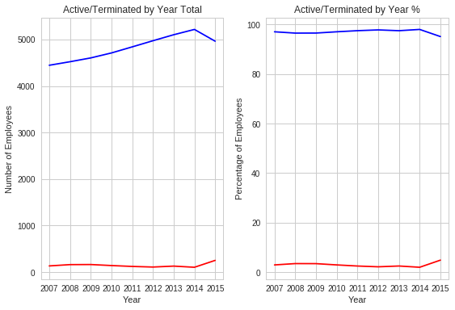
Employee Termination Rate by Year
Volume of terminations seems constantly over the years with small increase in the 2015

Slide 4
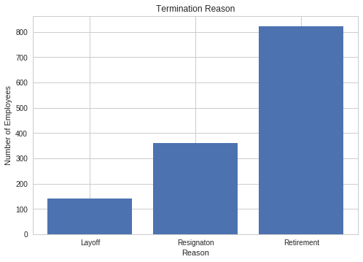
Termination by Reason
Most terminations due Retirement;
Retirement is not a attrition;
Pro active replacement of retirement employees;

Slide 5
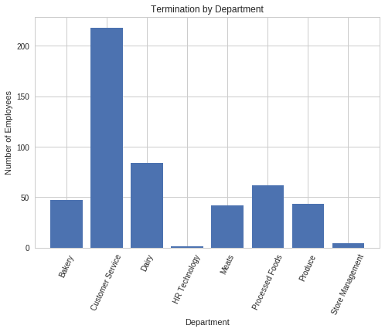
Termination by Department Unit
The department of Customer Service has the highest number of termination almost four times the number of the others departments

Slide 6
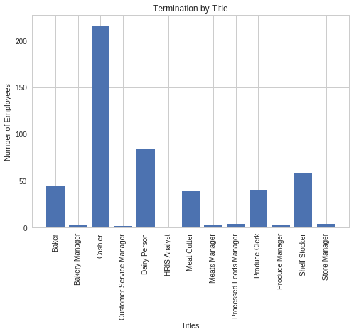
Termination by Title
Some functions correspond to more than 93% of the termination to each department.

Slide 7
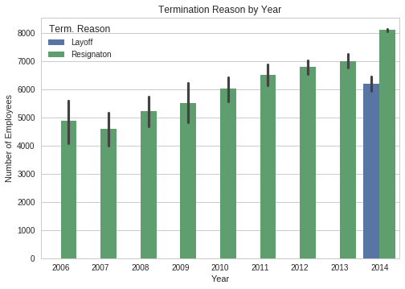
Termination Type
Termination by Layoff just happen in 2014;

Slide 8
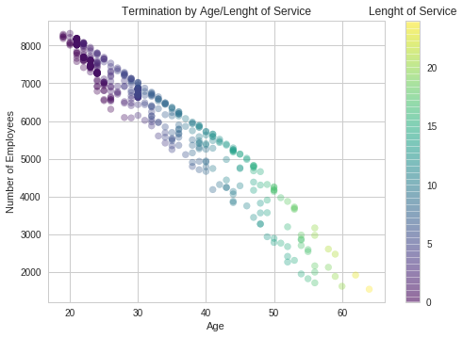
Termination Counts
Most of terminations occur when the employee is younger and have few time of service;
It could the first job;
He leaves the company;

Slide 9
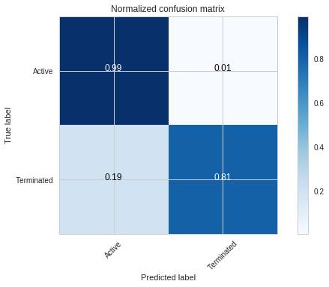
Model: Decision Tree Classifier
Test set accuracy: 98.9036%
True positive: 99%
True negative: 19%
False positive: 1%
False negative: 81%

Slide 10
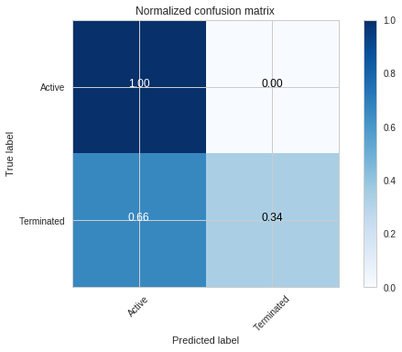
Model: Logistic Regression
Test set accuracy: 98.0385%
True positive: 100%
True negative: 66%
False positive: 0%
False negative: 34%

Slide 11

Model: KNeighbors Classifier
Test set accuracy: 97.9863%
True positive: 100%
True negative: 63%
False positive: 0%
False negative: 37%

Slide 12
Next Steps
Classification Tree
Hyperparameters Tuning using Grid Search, Random Search, Genetic Algorithms...
Feature Selection
Cross validation
Select Ensemble Tree models as Bagging or Random Forest
Logistic Regression
Hyperparameters Tuning using Grid Search, Random Search, Genetic Algorithms...
Regularization (Rigde or Lasso)
Choose other linear algorithm (SVM)
Preprocessing data (scaling, center)
KNN
Preprocessing data (scaling, center)
Choose another method to calculate the distance
Use PCA to dimensioning reduction and plot and analyse how the data is classified

